Slide 1
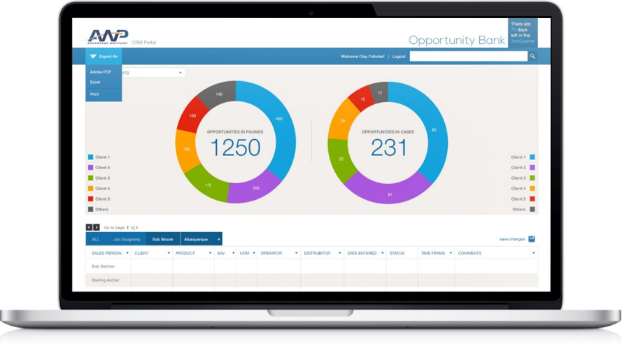
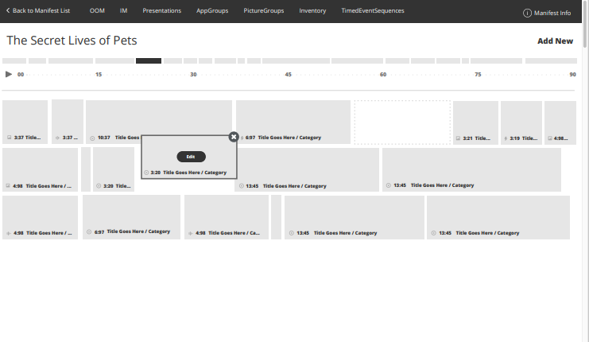
NBC Universal - Cross-Platform-Extras Media Manifest Editor
Business Need
NBC needed a way for their creative team to make edits to their Cross-Platform-Extras Media Manifest XML files. Editing the XML files directly through a text editor was not intuitive for their users and was prone to errors. They needed a tool that would allow them to change the content they know need editing but without dealing with technical edits of XML files.
What We Did
Affirma designed and created a web application that could load a Cross-Platform-Extras Media Manifest XML file and provide a user-friendly interface for editing content.
This application eliminated the need for NBC’s creative to deal with XML files directly and instead could change content in away that made sense to them.
The application also integrated NBC’s proprietary content management system to that images and videos could be selected from validated sources instead of free form text entry.

Slide 2
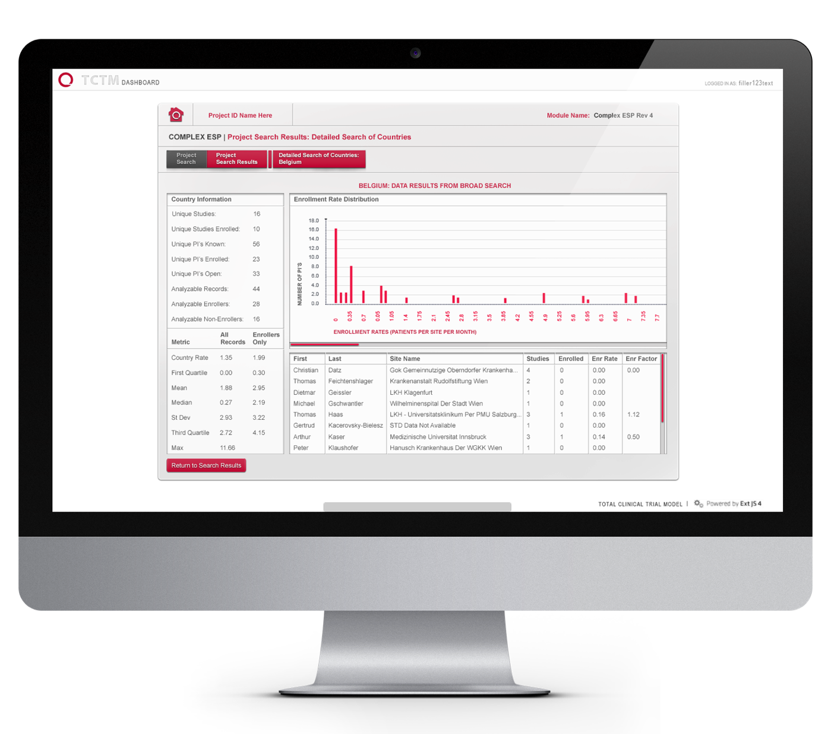
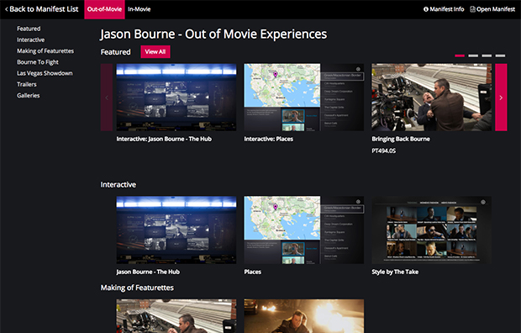
NBC Universal - Cross-Platform-Extras Media Manifest Emulator
Business Need
NBC was looking for a way to quickly visualize the content that they create for movie extras. The movie extras packages they create are in XML and are not easily understood in their raw format. Quality control needed a way to quickly check the content of a movie extras package.
What We Did
Affirma designed and built a web application that could render a Cross-Platform-Extras Media Manifest XML file in an intuitive, user-friendly way.
The application can be accessed from anywhere and is responsive across device sizes.
Integrations were done so content from NBC’s proprietary content management system can be pulled in.
NBC open sourced the application so that anyone interested can leverage the technology to view movie extras.

